Slide 1
English oral test assessment within the CEFR: Perception, variability and standardization.
Bárbara Eizaga Rebo
Bárbara Eizaga-Rebollar
barbara.eizaga@uca.es
David Levey
david.levey@uca.es
Sèvres, 31 May 2017

Slide 2
Challenges of oral testing
Achieving objectivity & reliability
Interpreting descriptors and criteria
Test standardisation
Test variability between examing boards
Time, resources, and training

Slide 3
THE SURVEY

Slide 4
Participants & Methodology
Compare content & effectiveness of 3 main accreditation tests for a C1 level in Spain:
Cambridge English Advanced (CAE)
Official Language School (EOI)
Open University (UNED)
Aim of the experiment
22 University student volunteers (19-22 yrs)
13 females /9 males with a C1
Students took 3 tests in different sessions
Students completed a questionnaire after each test
Students were rated by experts following the marking criteria of each exam board.

Slide 5
CANDIDATE QUESTIONNAIRE
Did the format of the oral exam allow you show your true level of English?
Did you think the duration of the exam was adequate?
Did you think the topics of conversation were easy to talk about?
Do you prefer to do an exam of this type alone or in pairs? Please give your reasons
What did you consider the most stressful element of the exam to be?
Did you deliberately include language items to impress the examiner?

Slide 6
CANDIDATE QUESTIONNAIRE
7. Did you make a particular effort to pronounce in a way you would not do normally?
8. Did you leave the exam with a clear idea of how you did?
9. What would you change in an oral test to make it more student friendly?
10. Which exam format do you prefer?
a) An individual face-to-face exam with 1 examiner
b) An individual face-to-face exam with 2 examiners
c) A conversation with a partner while 1 examiner listens & marks
d) A conversation with a partner while 1 examiners listens & the other one marks
e) A computer-based oral test

Slide 7
Cambridge Advanced Exam (CAE)
2 candidates / 2 examiners (1 interlocutor 1 judge: fixed roles)
Time: 15 minutes (no preparation time)
TEST FORMAT
General Questions (2 minutes)
Topic based activity ( 4 minutes)
Task solving interaction in pairs (4 minutes)
Discussion (interlocutor led) (5 minutes)

Slide 8
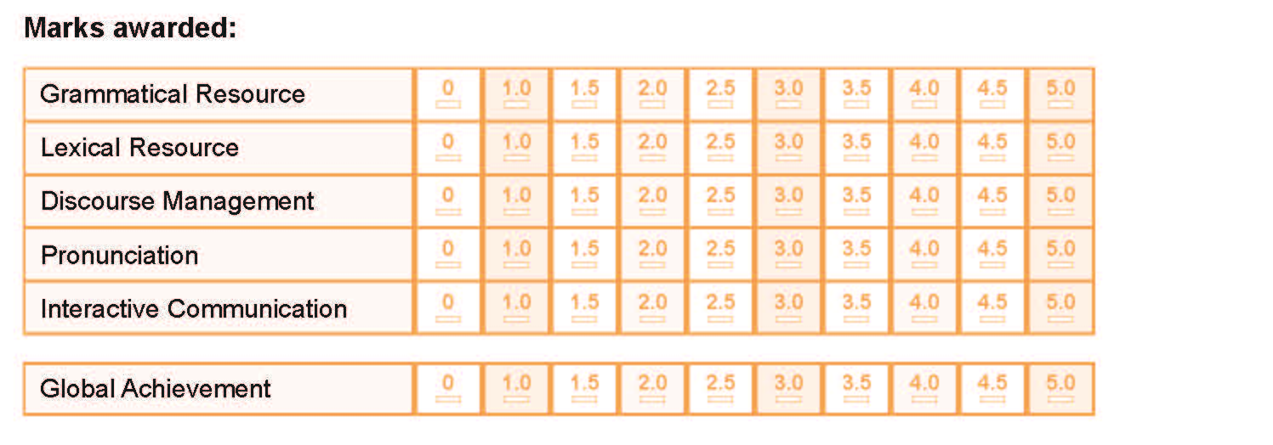
Cambridge English Advance (CAE): Assessment sheet

Slide 9
CAE: Scoring scale for speaking test
Practice test score
Grammatical resource | 5 max. x 2
Lexical resource | 5 max. x 2
Discourse management | 5 max. x 2
Pronunciation | 5 max. x 2
Interactive communication | 5 max. x 2
Global achievement | 5 max. x 5
TOTAL MARK | 75 points max.

Slide 10
CAE: Scoring scale for speaking test
Practice test score | Cambridge English Scale Score | CEFR level
66 | 200 | C2
45 | 180 | C1
30 | 160 | B2
17 | 142* | -
* Minimum score reported for Advanced

Slide 11
OFFICIAL LANGUAGE SCHOOL (EOI)
2 candidates/ 2 examiners (1 interlocutor & 1 judge interchanging roles during the test)
Time: 30 minutes (15 minutes max. preparation; 15 minutes max. exam)
TEST FORMAT
Individual monologue (3-4 minutes maximum)
Dialogue with partner (6-8 minutes)

Slide 12
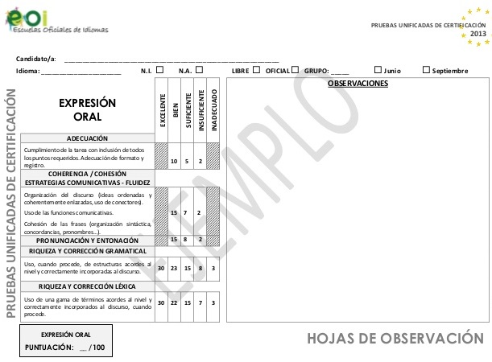
Oral expression assessment sheet:

Slide 13
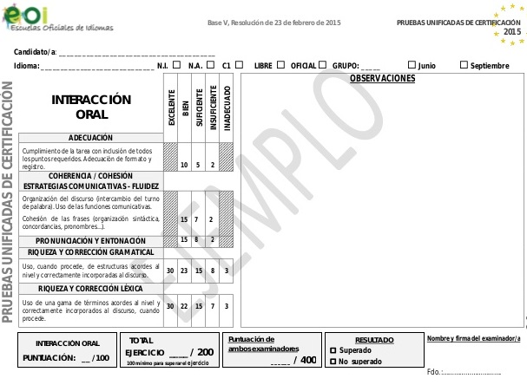
Oral interaction assessment sheet

Slide 14
EOI rating scale
Monologue | Test score | Total
Task completion | 10 pts max. | 100 pts max.
Cohesion & coherence: Communicative strategies - Fluency | 15 pts max.
Pronunciation & intonation | 15 pts max.
Grammar accuracy & depth | 30 pts max.
Lexical accuracy & depth | 30 pts max.
Oral interaction
As above | As above | 100 pts max.
Combined total | Pass : 200 pts | 400 pts max.

Slide 15
UNED EXAMINATION FORMAT
1 candidate / 1 examiner (interlocutor & judge)
Time: 9-11 minutes and a separate listening.
TEST FORMAT
Monologue on a given subject
(6-8 mins + 3 mins preparation) speaking
Dialogue (3 mins) with interlocutor
A listening test of 2/3 extracts played twice
30 questions (short answers + multiple choice)

Slide 16
Oral production (speaking)- UNED rating scale
Comunicative Efficiency Comprehensability Communicative functions Sociolinguistic usage | 2 points max.
Discourse Management Coherence, organization & development | 2 points max.
Language Depth Lexis, grammar, cohesion adequate for C1 level, coherent use of tenses | 3 points max.
Accuracy Wide lexical & grammar repertoire Use of complex structures and uncommon lexis Correct pronunciation and intonation | 3 points max.
Pass mark | 6 points + 50% of the listening questions

Slide 17
Comparative exam chart
Exam length | Preparation time | Exam format | Exam content
CAE –15 mins | NONE | 2 candidates (C C) 1 judge +1 interloc (J+ɪ) | General questions (ɪ C) Topic-based activity (C) Task based (C C) Discussion ɪ (C C)
EOI – 15 mins | 15 mins. | 2 candidates – 2 judge/interloc. (J/ɪ) | Individual monologue (C) Dialogue ɪ (C C)
UNED – 11 mins | 3 mins. | 1 candidate – 1 judge/interloc. (J/ɪ) | Monologue (C) Discussion (J/ɪ C)

Slide 18
Research
findings

Slide 23
4. Reasons for preferring to do the test in pairs or alone
IN PAIRS | Feel less pressure Gives confidence Partners can help if stuck More comfortable discussing a topic
ALONE | No need to adapt opinions to the task. No peer listening to you More freedom to organise discourse & consider questions No sense of competition More objective assessment
BOTH | Dialogue task in pairs; monologue, alone.
DEPENDS | If partner’s level is higher, alone; if the same or lower, in pairs.

Slide 24
5. What did you consider the most stressful element of the exam to be?
CAE | EOI | UNED
22%: Reacting to picture prompts | 18%: Limited time to prepare topics | 23%: Unfamiliar topics
22%: Being recorded | 14%: Convincing or disagreeing with a partner when not your true opinion | 23%: Nothing
18%: Limited time to consider questions & complete tasks | 14%: Not knowing how long the discussion should last | 14%: Being recorded
14%: Nothing | 14%: Nothing | 10%: No topic choice

Slide 28
9. What would you change to make the test friendlier?
CAE | Start with an easy task to make candidates feel at ease Allow students to choose partners and topics Reveal the topics before the exam Less specific to facilitate freer conversation More real-life conversation tasks More time to think of the answers
EOI | Include warm-up questions Wider topic choice Easier topics More interactive tasks involving examiner More real-life conversation tasks Reveal the topics before the exam
UNED | Clearer information on exam structure Include warm-up questions More examiner involvement in the exam Allow choice of topics

Slide 29
Preferences | 10. Which exam format do you prefer?
1st option | An individual face to face exam with 1 examiner
2nd option | A conversation with a partner while 1 examiner listens and rates
3rd option | A conversation with a partner while 2 examiners listen and rate
4th option | An individual face to face exam with 2 examiners
5th option | A computer-based oral exam

Slide 30
Judges’ perception | Students’ perception
UNED = least satisfactory Why? | UNED = preferred test Why?
Uses only 1 activity | Felt test allowed them to show true level of English
Multi-tasking: judge/interlocutor | 1 judge is less nerve-wracking
Too short (11 min) | Short test Preparation time given
Topic too general Not conducive to showing true level Onus on candidate to impress | Familiar & student-friendly topics

Slide 31
Judges’ perception | Students’ perception
EOI = not as satisfactory as CAE, but better than UNED Why? | EOI = second preferred test Opinions/comments
Uses 2 different tasks, but no ice-breakers | Time to prepare tasks (15 min.) seen as positive
Interchanging roles of judge/ interlocutor confuses students | Presence of 2 participating examiners was stressful Uneven preparation time distribution
Topics are too specific & artificial | Unfamiliar topics Topics difficult to discuss (even in native language)
Appropriate test duration | Artificial dialogue Obliged to defend opinions which were not their own

Slide 32
Judges’ perception | Students’ perception
CAE = most complete Why? | CAE = implied most effort Why?
Uses 4 different tasks | Having 4 different tasks caused more stress than other tests
Roles for judge & interlocutor are differentiated | Stressful to have 2 examiners in the room Silent presence of a judge caused stress
Topics appropriate to the level | Lack of topic choice was unpopular
Adequate test duration | Test in pairs considered: positive for some (when partner had similar or lower level) negative for others (when partner had higher level)

Slide 33
Future research lines
Further work on test standarisation is needed to achieve a realiable and objective oral test, which can be applied to other languages.
Clearer descriptors and assessment criteria need to be developed.
More focus on test administration training & timing standardisation is needed
Explore possibility of a time and resource efficient computer-based test.

Slide 34
Merci beaucoup
Thank you very much

